Slide 1


Visualization Methods for Deep Learning Interpretability - Final presentation (P4)
Sébastien David, Matthieu Desse, Antoine Hue, Romain Legrand
June 25th 2020
Notes:
· Rappeler très brièvement le contexte et les enjeux du projet
· Décrire les moyens (humains, techniques, méthodologiques) mis en oeuvre pour atteindre les objectifs ainsi que les difficultés rencontrées
· Présenter la solution proposée, ses avantages/limites et esquisser des perspectives de développement futur.

Slide 2
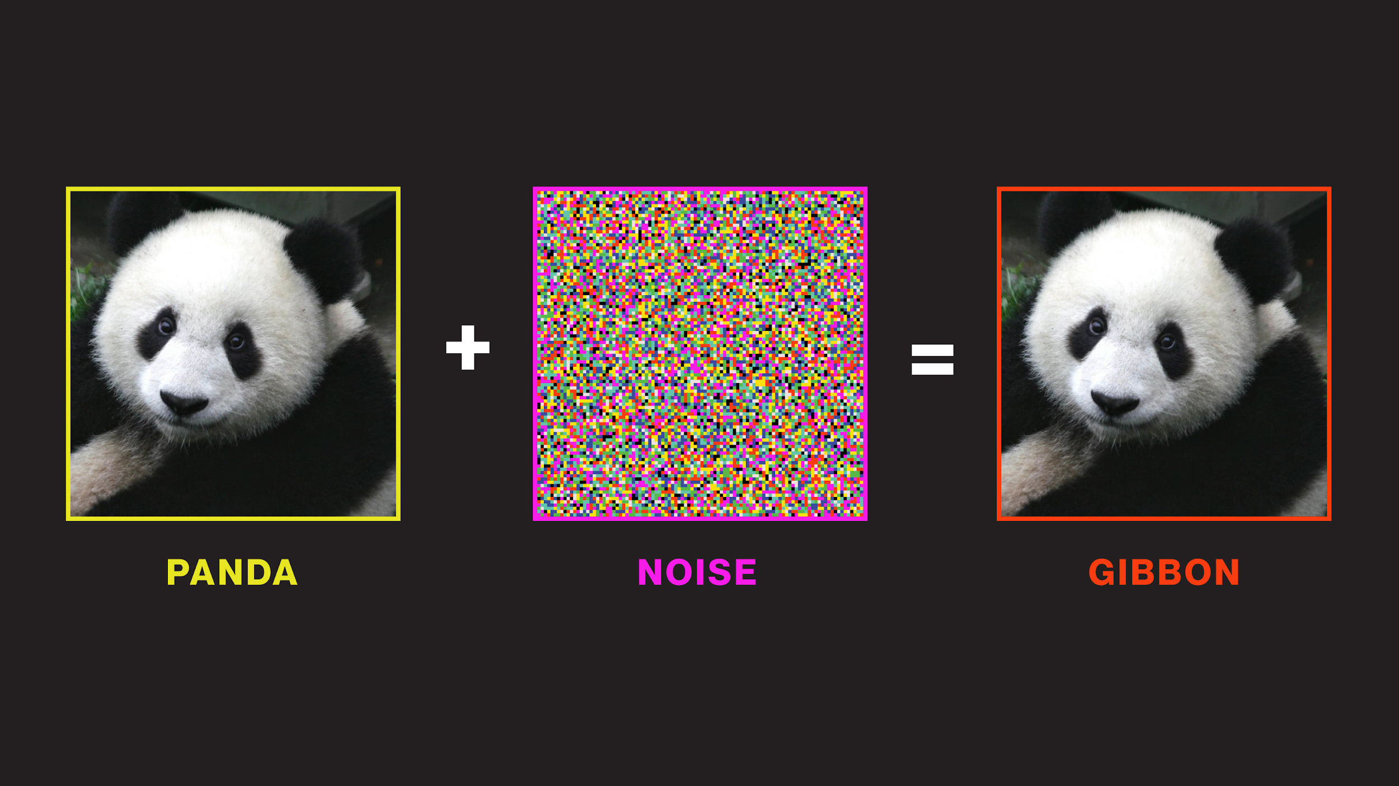
Context, organisation and challenges
Notes:
Durée : 4 minutes

Slide 3
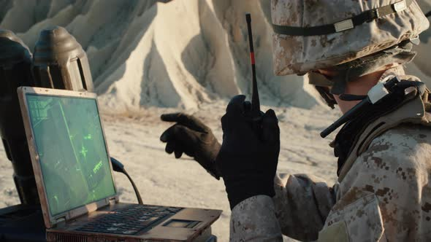
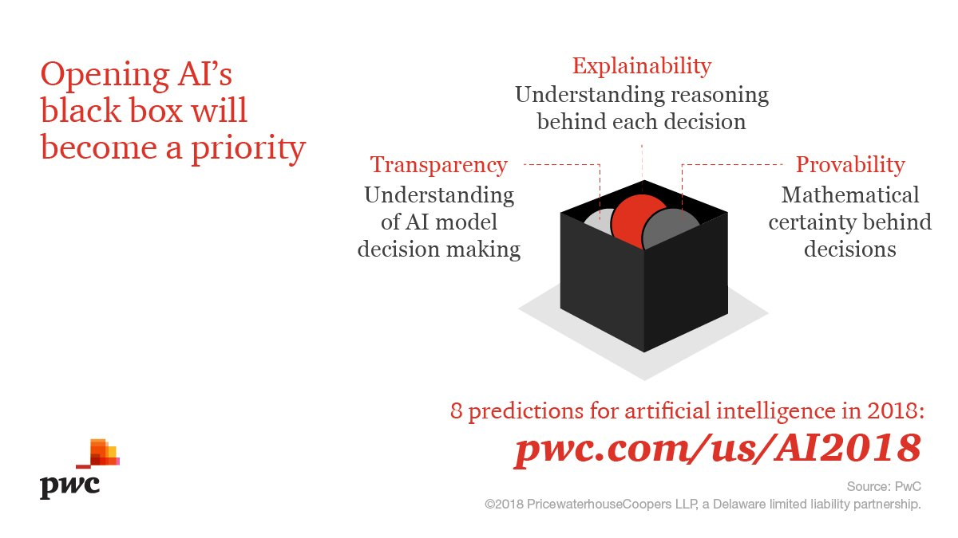
Context
Ministère des Armées’ interest for Deep Learning applications to treat massive data
Applications : assisting soldiers on the battlefield, geo-spatial localization, telecommunications, intelligence, etc,.
AAA
Project goals
Deep Learning = black-boxes
Answer interpretability deficiencies during model training …
… or at prediction time
Monitor DNN during training
Notes:
The Ministry uses some DNN to response to this need.
Indeed, training phase has high cost (time and hardware)
The Ministry need to observe the good or not training of a DNN through 2 main axis :
Understanding training phase and the invariant of a DNN on a specific task
And define metrics to monitor this train.

Slide 4
Roadmap
08/01/2020
1st Phone Call with Ministère
28/04/2020
P3 Presentation (distanced learning)
11/2019
Project launch
04/02/2020
P2 Presentation + 1st Meeting with representatives from Ministère
25/06/2020
Final presentation +
Documentation
Research literature review
State-of-the-art
Technology review
Initial POC
Prototyping different interpretability methods
Conclusion of our POC
Improvements
Documentation

Slide 5
Setbacks and challenges
A complex partnership :
No feedbacks, no constraints neither directives
Difficult to challenge our work with operational needs
Some ML issues :
A very popular subject with a high potential for professionals, researchers with a limited state of the art
Difficult and onerous scaling
Need to dive into data visualization of DNN (often complex because of DNN nature : multi-layer, huge neuron number.
Notes:
Very low interactions with our partner :
No feedbacks, no constraints neither directives
Difficult to challenge our work with operational needs
The Ministry need to observe the good or not training of a DNN through 2 main axis :
Understanding training phase and the invariant of a DNN on a specific task
And define metrics to monitor this train.
… complicating our initial literature review and POC
Research topics dropped : saliency maps and adversarial attacks
Very few research boundaries : dataset (CIFAR-10) and models (either LeNet-5 or pretrained architectures)
Initial sole interest in training phase monitoring expanded to prediction

Slide 6
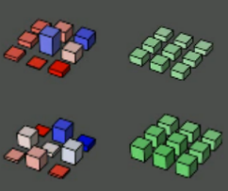
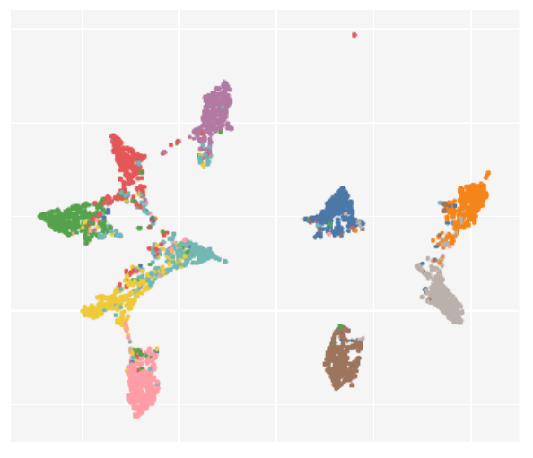
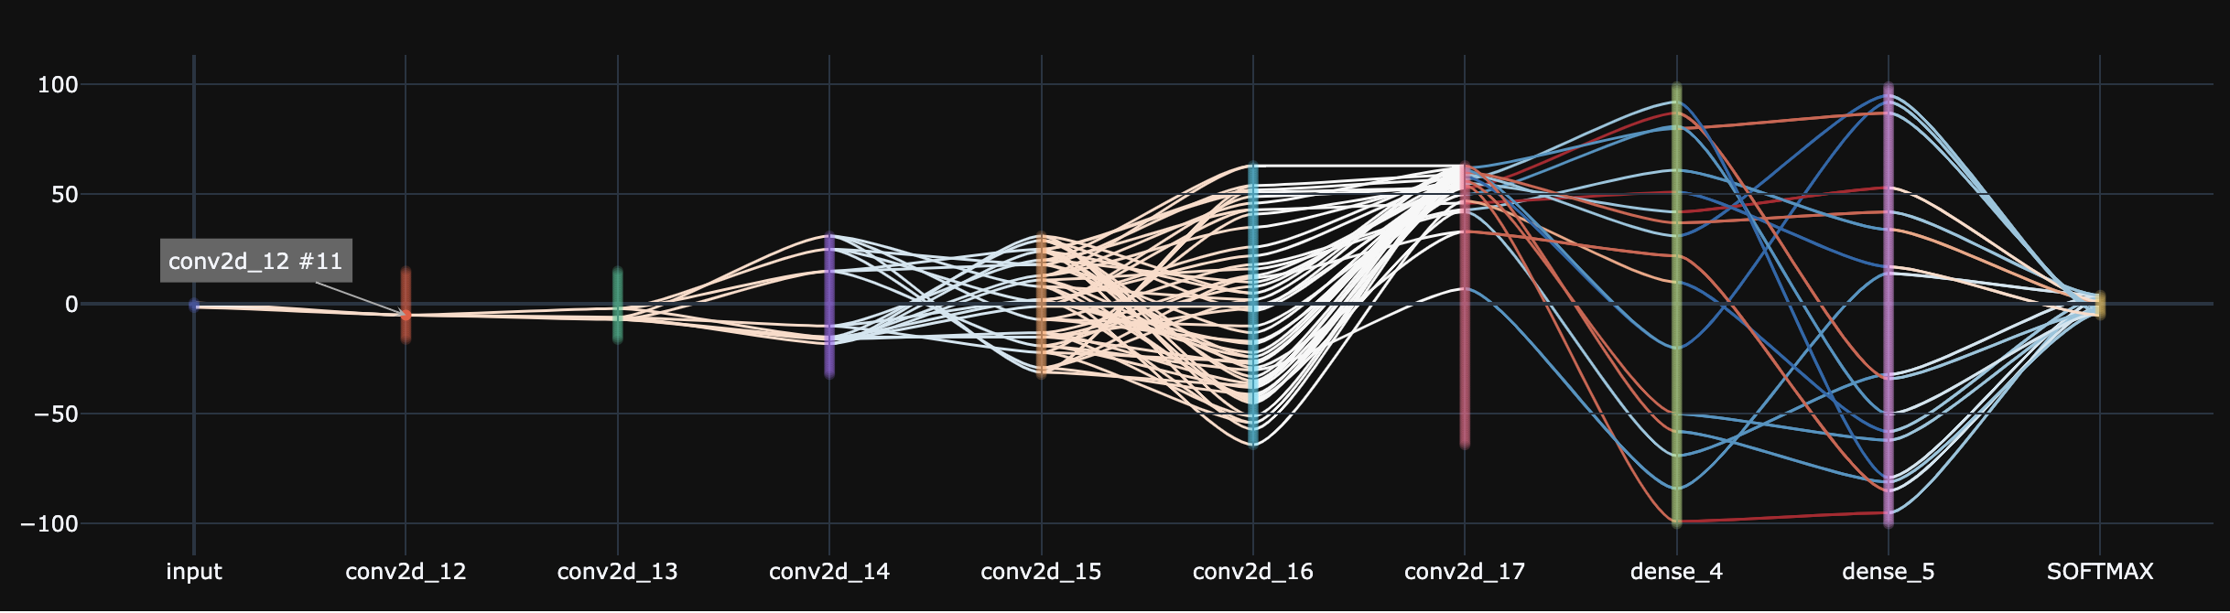
Our solution
Deep Learning Interpretability is a vast research scope
Exploring different perspectives (and goals)
3 complementary concepts
DNN-Monitor
Embedding Viewer
DNN-Viewer
(a)
(b)
(c)

Slide 7
Organization
a
Romain LEGRAND
Matthieu DESSE
DNN-Monitor
CIFAR-10
LeNet-5
b
Sébastien DAVID
Deep Embedding Viewer
CIFAR-10
VGG-16
c
Antoine HUE
Matthieu DESSE
DNN-Viewer
CIFAR-10
LeNet-5, GAN

Slide 8
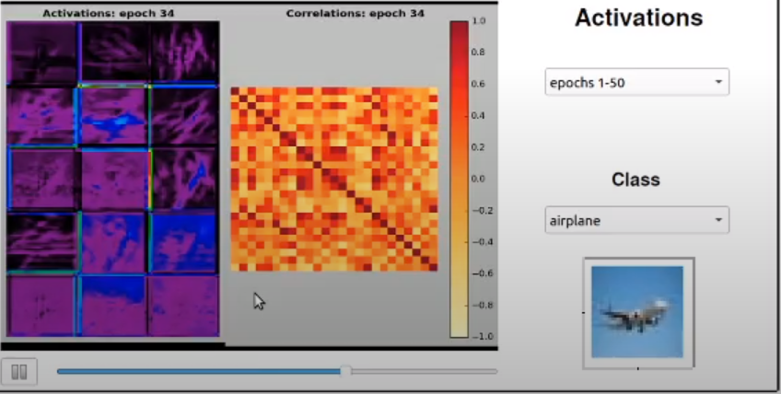
DNN-Monitor
Monitor evolution of baseline metrics across epochs
Notes:
Durée : 3 minutes

Slide 9
Observations and Intuitions
Quality of training primarily determined by update of coefficients
Gradient and weights are two main concepts in DNN (forward and back-propagation).
The aim is to create several custom metrics to visualise the evolution of the system across epochs
Visualization of custom metrics:
loss and accuracy
weights and gradients
activations and correlations between filters

Slide 10
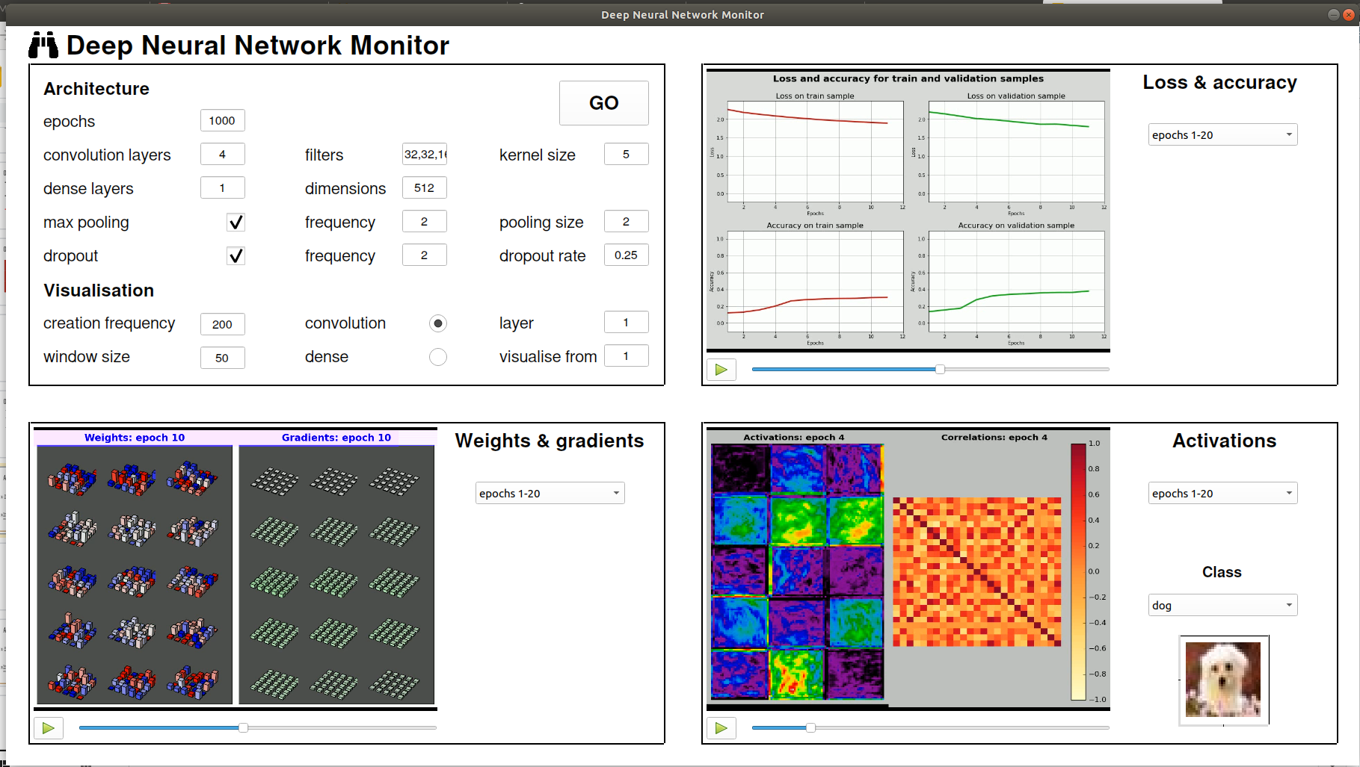
A GUI splits into 4 parts
Visualise evolution of training/validation loss and accuracy
Define an architecture
1
2
Visualise activations and correlations between filters
Visualise weights and gradients evolution
3
4

Slide 11
Interactive Demo

Slide 12

Offline Demo

Slide 13
Deep Embedding Viewer
Visualizing Layer Representations with Dimensionality Reduction
Notes:
Durée de la slide : 15 secondes

Slide 14
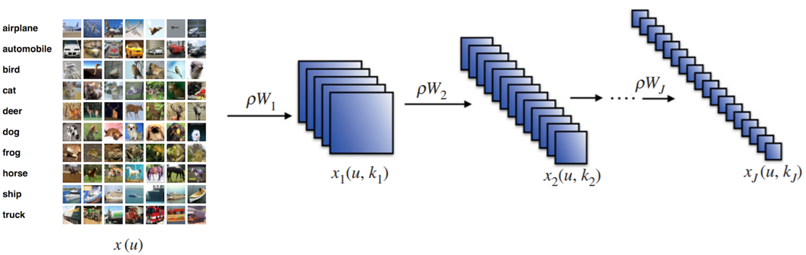
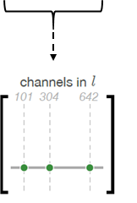
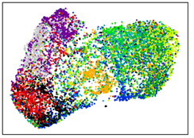
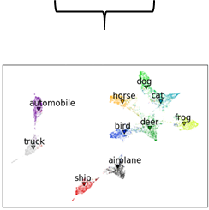
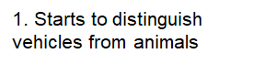
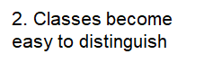
Deep Embedding Viewer Refresher
Embeddings
Notes:
Durée de la slide : 45 secondes

Slide 15
Tech Demo

Slide 16
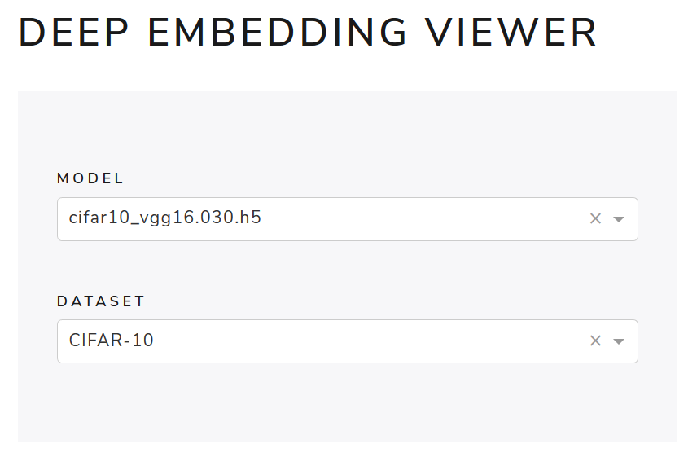
Deep Embedding Viewer Demo: VGG-16 on CIFAR-10 (86% Test Accuracy)
Notes:
BACK-UP SLIDE

Slide 17
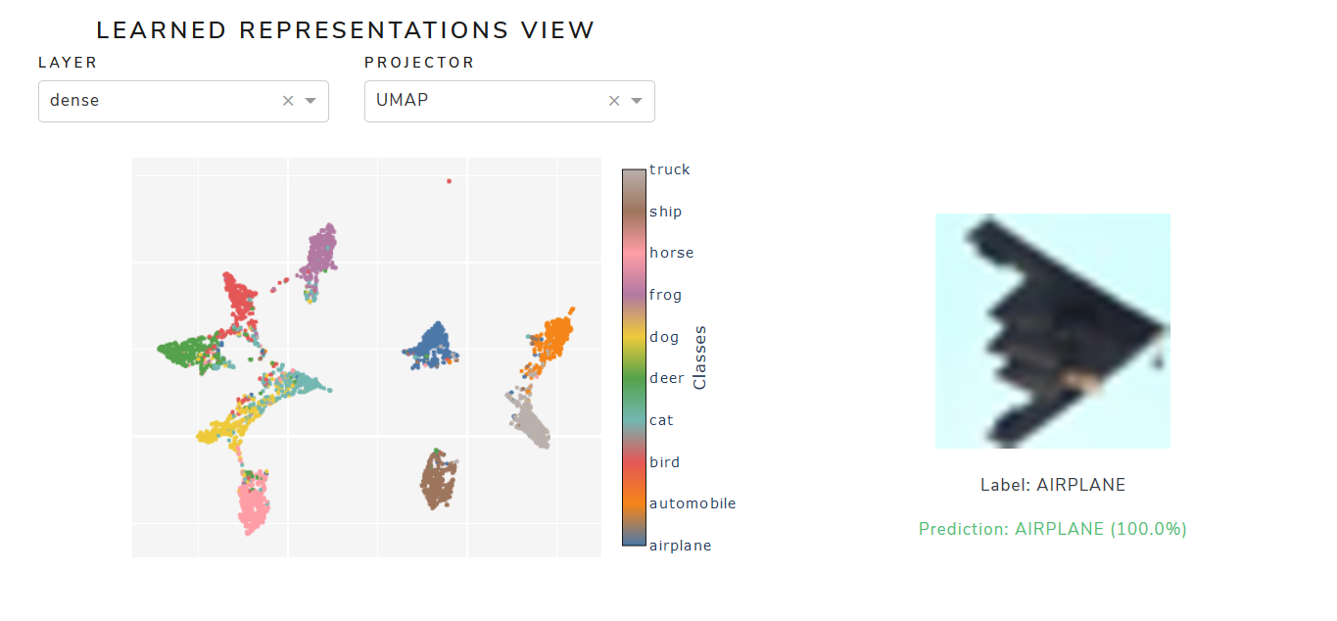
Deep Embedding Viewer Demo: VGG-16 on CIFAR-10 (86% Test Accuracy)
Notes:
BACK-UP SLIDE

Slide 18
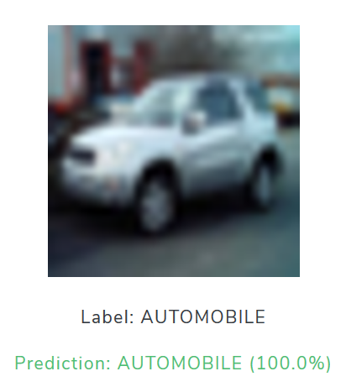
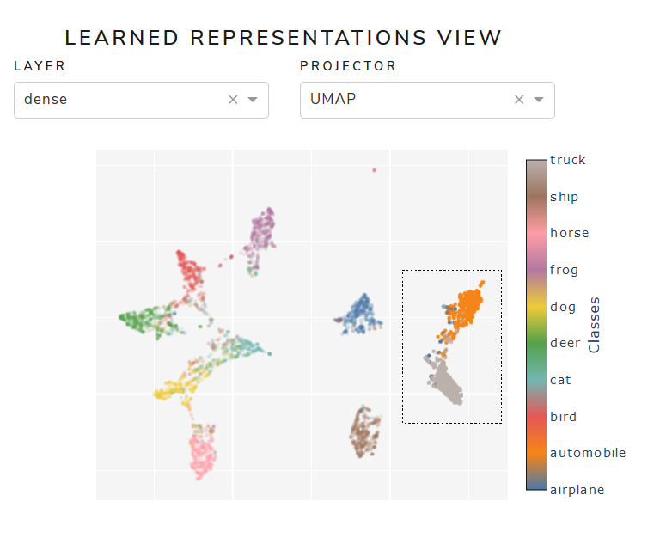
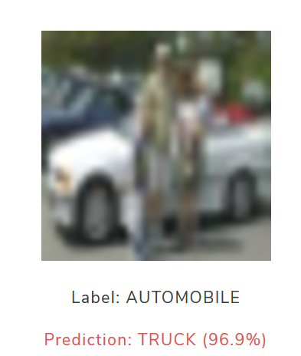
Deep Embedding Viewer Demo: VGG-16 on CIFAR-10 (86% Test Accuracy)
Notes:
BACK-UP SLIDE

Slide 19
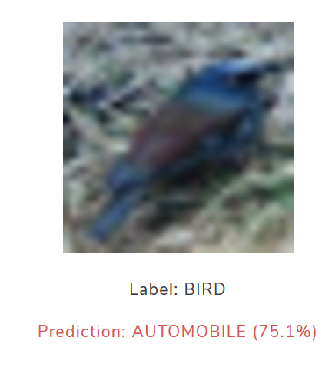
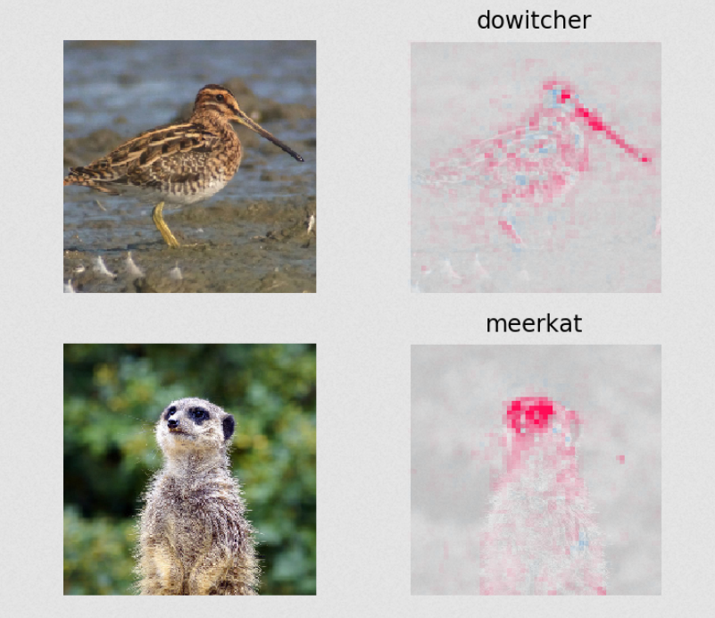
Deep Embedding Viewer Demo: VGG-16 on CIFAR-10 (86% Test Accuracy)
Solution: SHAP Coefficients ?
Notes:
BACK-UP SLIDE

Slide 20
Inspection of - architecture, - learnt parameters, - performance over epochs
DNN Viewer
$ pip install dnnviewer
Notes:
Durée : 3 minutes

Slide 21
Observations and Intuitions
Most techniques presented in the bibliography are assuming a layer or unit has been selected
A graphical user interface to click and select units would be very helpful
Each unit should be evaluated with test data (e.g. activation, saliency) and within the network graph
The user interface will allow navigation up and down the graph
Even the consolidated views over a dataset (e.g. t-SNE, UMAP) require layer/unit selection

Slide 22
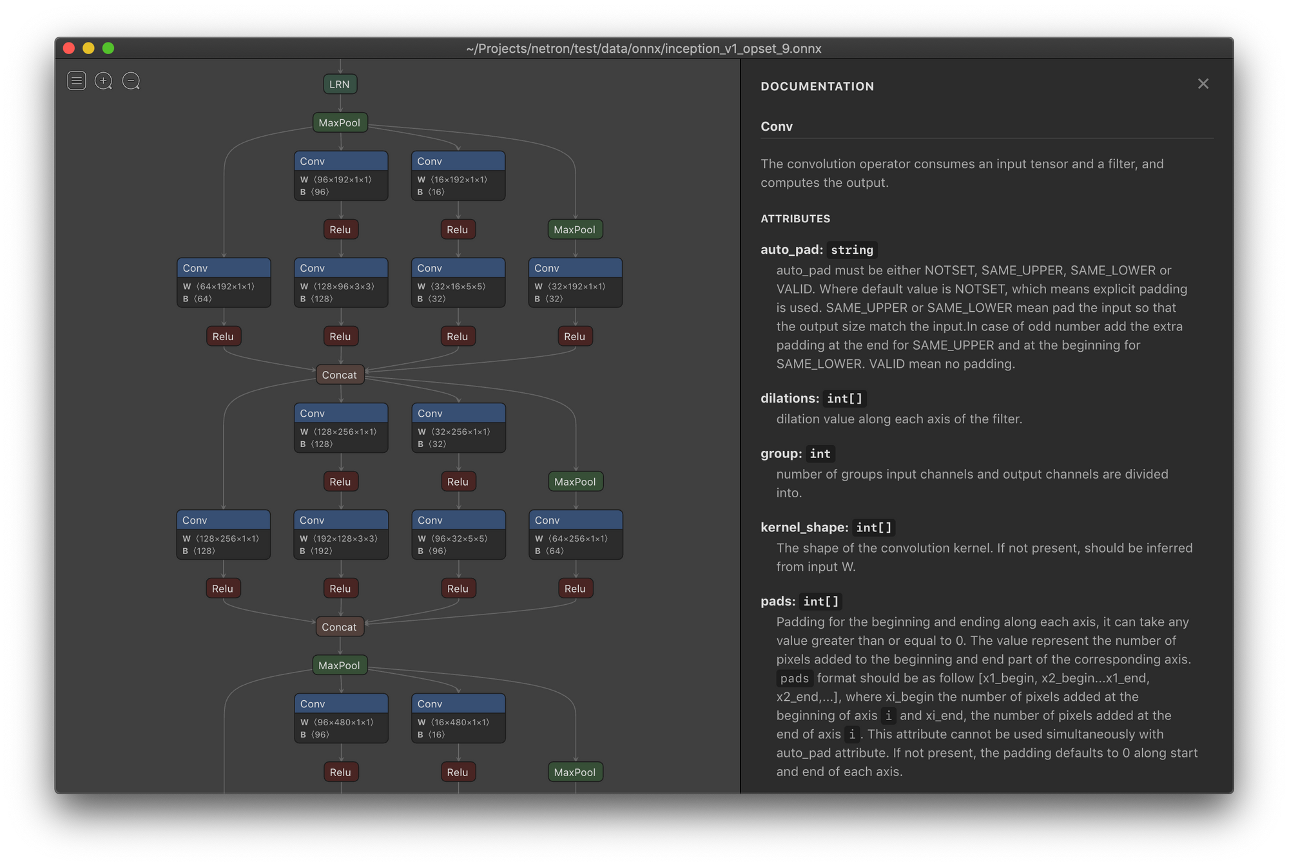
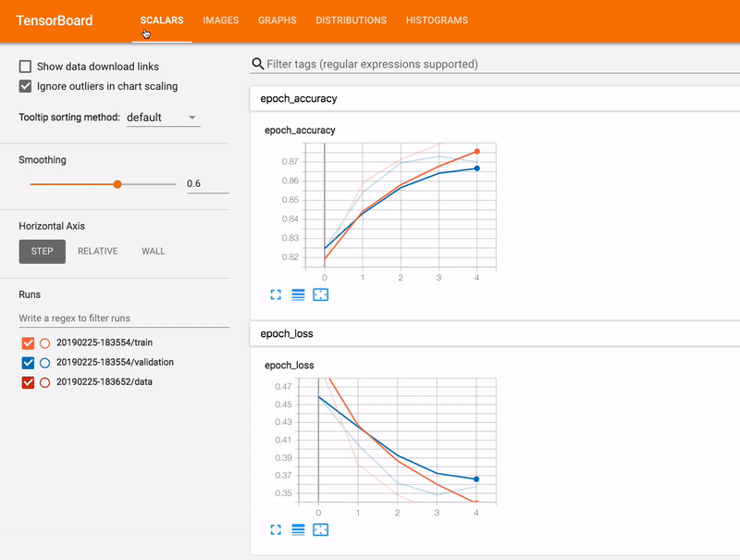
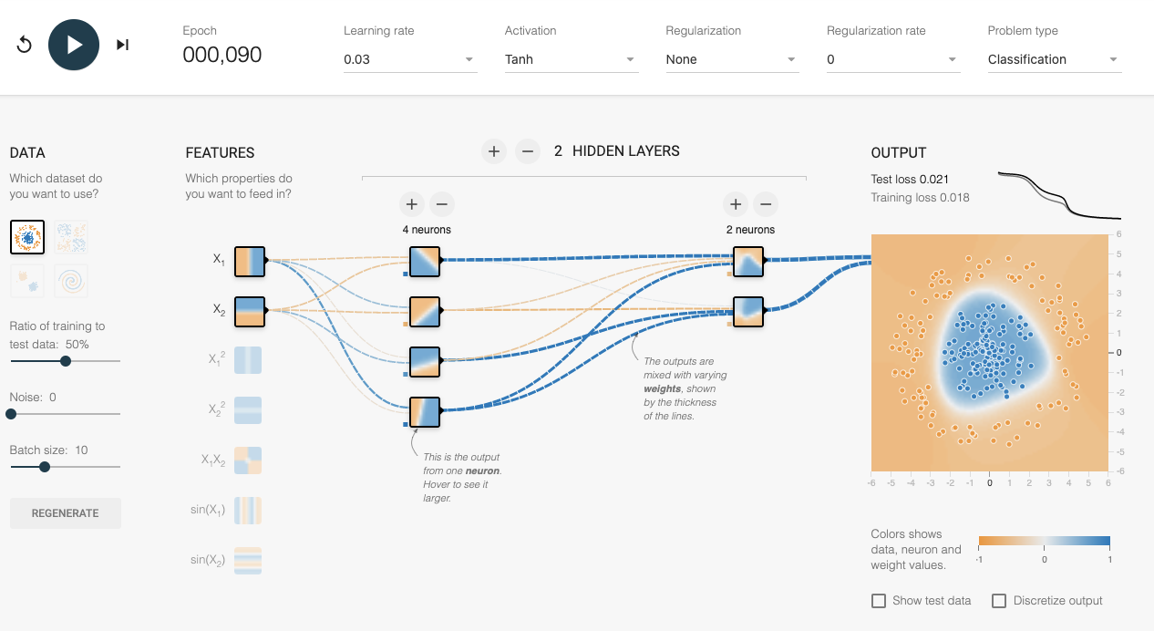
Netron
Tensorboard
playground.tensorflow.org

Slide 23
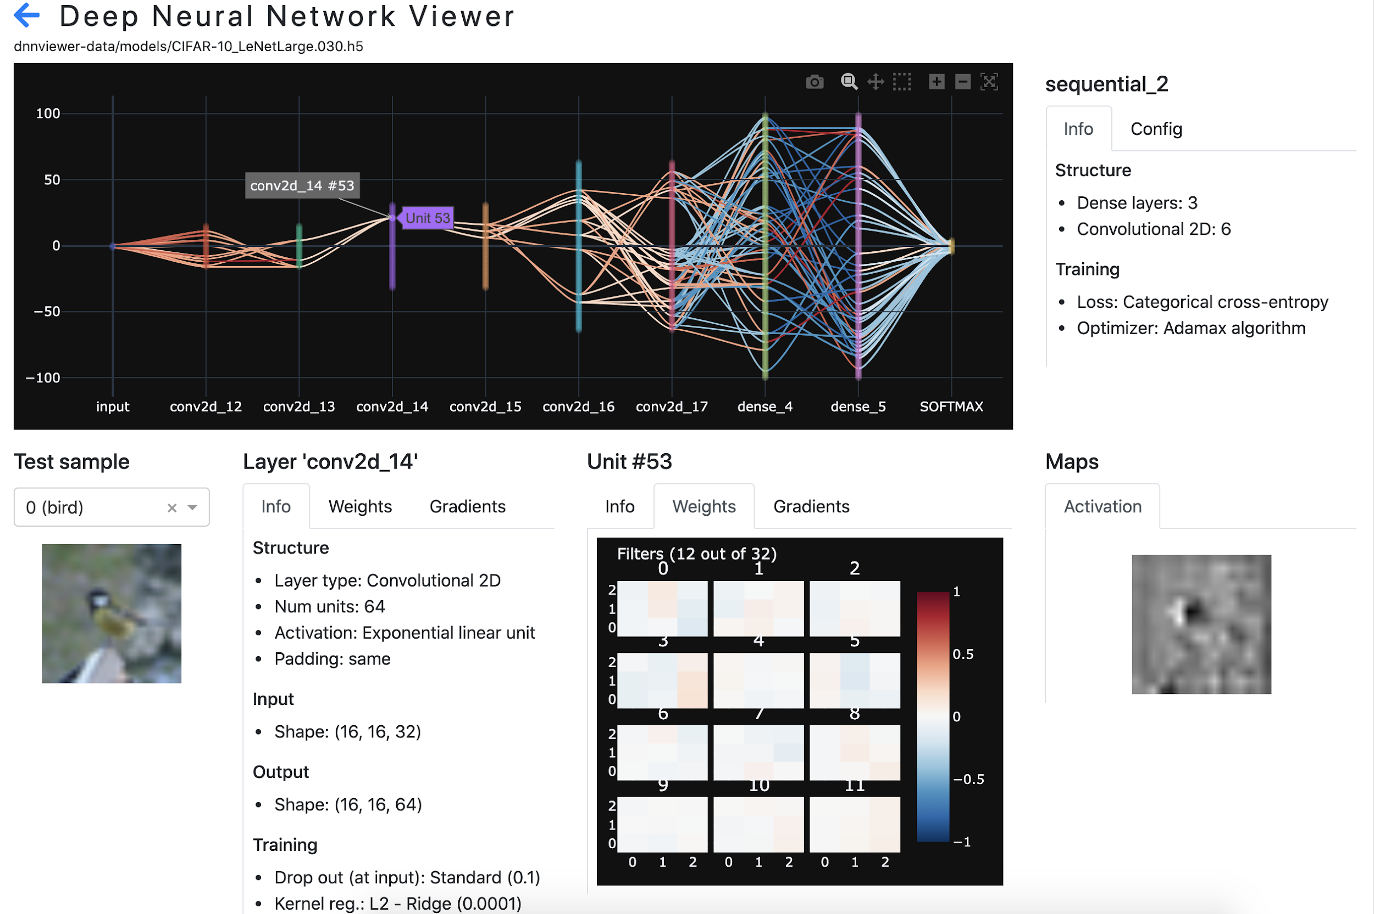
Deep Neural Network Viewer https://github.com/tonio73/dnnviewer
A graphical user interface to inspect:
architecture,
learnt parameters
gradients
activation maps
of a deep neural network
Distributed on Pipy
$ pip install dnnviewer

Slide 24
Interactive Demo
DNN Viewer

Slide 25
Conclusion

Slide 26
Improvement axis
Aggregate these tools to obtain a coherent tool,
Integrate research topics dropped : saliency maps and adversarial attacks,
Develop custom metrics,
Explore and generalise tool for other architecture and dataset.

